Slide 1

School of Computer Science and Engineering
Intelligent Learning Platform Development
External
Project Guide:
Prof. Sheela S
Assistant Professor
External Guide:
Anush G R
School of Computer Science and Engineering
RV University, Bangalore
Team members:
1RVU23CSE125 - C J Sakshi
1RVU23CSE162 - Gagana K
1RVU23CSE280 - Mohammed Ismail
1RVU23CSE369 - Rakshitha K

Slide 2
Contents
Title and Problem definition
Introduction & Scope
Objectives
Literature Survey
Methodology
Requirement Specification
Design approach
Architecture diagram
Innovation
Hardware & Software Requirements
References

Slide 3
Problem Definition
Necessity and Benefits:
Traditional interviews require significant human effort and time.
Resume screening is often manual, subjective, and inconsistent.
Recruiters struggle to assess technical depth early in the hiring process.
Benefits:
Automates early-stage candidate screening
Ensures consistent and unbiased questioning
Saves recruiter time and cost
Provides structured feedback and scoring
This can be adopted for practicing the interviews beforehand for freshers and those who wants the experience of interviews.

Slide 4
Problem Definition
Relevance:
AI-based recruitment is widely adopted in industry HR systems
Relevant to AI, NLP, Software Engineering, and Data Science
Addresses real-world hiring challenges
Expected Outcomes:
Resume-based skill extraction
Adaptive interview question generation
Candidate capability scoring
Personalized dashboard for candidates

Slide 5
Introduction - Background
Background:
Growth in job applications makes manual screening infeasible
Existing systems rely heavily on keyword filtering
Lack of deep skill evaluation before interviews
Technology Context:
Advances in NLP and Large Language Models
Availability of cloud platforms and AI APIs

Slide 6
Problem Statement and Scope
To design and develop an AI system that:
Parses resumes
Extracts relevant skills
Conducts adaptive interviews
Evaluates candidate responses objectively
Scope of the Project
Included:
Resume upload and parsing
Skill extraction
Question generation
Answer evaluation
Excluded (current phase):
Live video interviews
Full enterprise ATS integration

Slide 7
Objectives
Primary Objectives:
Automate early interview screening
Reduce recruiter workload
Improve interview consistency
Specific Objectives:
Extract CV–JD skill overlap
Generate multi-level interview questions
Evaluate answers using AI
Store interview summaries
Build a scalable foundation

Slide 8
Literature Survey
1. Resume Parser Using AI [1]
Problem Addressed
Manual resume screening is time-consuming and inefficient, especially when dealing with large numbers of applicants.
Methodology
The system uses Natural Language Processing (NLP) techniques to extract structured information from unstructured resume documents.
Key steps include:
Resume text extraction
Text preprocessing
Named Entity Recognition (NER)
Skill and experience extraction
Key Findings
AI-based resume parsing significantly improves recruitment efficiency by automatically extracting candidate information such as skills, education, and work experience.
Advantages
Reduces manual recruiter workload
Improves speed of candidate screening
Handles large numbers of resumes
Limitations
Works only at the resume screening stage
Does not evaluate candidate responses in interviews
Research Gap
Integration of resume parsing with interview automation systems is not explored.

Slide 9
Literature Survey
2. AI Bot for Interview Preparation [2]
Problem Addressed
Candidates often lack realistic environments for interview practice.
Methodology
The system uses:
React for frontend
FastAPI for backend
OpenAI API for question generation
Azure Speech Services for voice interaction
Key Findings
AI chatbots can simulate interview conversations and provide feedback to help candidates improve.
Advantages
Interactive interview simulation
Voice-based conversation
Immediate feedback
Limitations
Questions are mostly predefined
Limited personalization
Research Gap
Interview questions are not generated from candidate resumes.

Slide 10
Literature Survey
3. AI-Based Interview System with Machine Learning [3]
Problem Addressed
Traditional interviews cannot objectively evaluate candidate behavior and communication.
Methodology
The system uses multimodal AI analysis, including:
Speech recognition
Sentiment analysis
Facial expression recognition using computer vision
Machine learning classifiers
Key Findings
Analyzing both speech and facial expressions provides better candidate evaluation compared to text-only analysis.
Advantages
Captures behavioral indicators
More holistic candidate evaluation
Limitations
Requires cameras and audio processing
High computational cost
Research Gap
Lightweight web-based AI interview systems are not addressed.

Slide 11
Literature Survey
4. AI-Powered Interview Assistant Chatbot [4]
Problem Addressed
Recruitment processes require scalable interview solutions.
Methodology
The system uses conversational AI techniques:
NLP for conversation understanding
Voice-to-text conversion
Text-to-speech synthesis
Sentiment analysis
Key Findings
AI chatbots can simulate real interview conversations and assist candidates in preparing for job interviews.
Advantages
Realistic conversation simulation
Scalable interview platform
Limitations
Limited contextual reasoning
Static conversation flow
Research Gap
Dynamic follow-up question generation is missing.

Slide 12
Literature Survey
5. AI-Powered Mock Interview System for Automated Skill Assessment [5]
Problem Addressed
Candidates often lack tools to objectively assess interview performance.
Methodology
The system uses:
MERN stack architecture
NLP-based semantic similarity algorithms
Speech recognition
Candidate answers are compared with expected answers.
Key Findings
Semantic similarity scoring can evaluate candidate responses automatically.
Advantages
Automated answer evaluation
Helps candidates identify weaknesses
Limitations
Evaluation limited to text similarity
Does not analyze reasoning depth
Research Gap
Advanced reasoning models such as LLMs are not used.

Slide 13
Literature Survey
6. Automated Interview Bot for Hiring Process Optimization [6]
Advantages
Reduces recruiter workload
Handles large candidate pools
Limitations
Limited capability for complex discussions
Research Gap
Dynamic conversation and adaptive questioning are not implemented.
Problem Addressed
Recruitment processes involve repetitive manual interview stages.
Methodology
The system uses:
NLP-based question generation
Machine learning algorithms
Sentiment analysis
Key Findings
AI bots can conduct preliminary interviews and filter candidates efficiently.

Slide 14
Literature Survey
7. Automated Interview Assessment System [7]
Advantages
Real-time interview evaluation
Automated communication analysis
Limitations
Requires webcam and microphone
Privacy concerns
Research Gap
Lightweight text-based evaluation approaches are not explored.
Problem Addressed
Manual evaluation of communication skills in interviews is subjective.
Methodology
The system analyzes candidate performance using:
Speech-to-text conversion
Facial expression recognition
Grammar analysis
Key Findings
Voice fluency and facial expressions can provide indicators of candidate confidence and communication ability

Slide 15
Literature Survey
8. Interview Bot: Automating Recruitment Process Using NLP and ML [8]
Advantages
Consistent evaluation criteria
Scalable recruitment system
Limitations
Difficulty understanding complex responses
Research Gap
Advanced language models capable of deeper reasoning are not used.
Problem Addressed
Recruiters struggle to evaluate many candidates efficiently.
Methodology
The system uses:
NLP-based question generation
Speech recognition
Sentiment analysis
Machine learning evaluation models
Key Findings
Automated interview bots can standardize interviews and reduce bias.

Slide 16
Literature Survey
9. Best Practices in REST API Design for Scalability and Security [9]
Advantages
Improved backend reliability
Easier integration between systems
Limitations
Focuses on backend architecture only
Research Gap
Application of REST architecture in AI interview systems is not explored.
Problem Addressed
Web applications require scalable and secure API architecture.
Methodology
The paper analyzes REST architecture principles including:
Stateless communication
Resource-based API design
Versioning strategies
Security practices
Key Findings
Proper REST API design improves scalability and maintainability of distributed systems.

Slide 17
Literature Survey
10. Evaluating the Efficacy of Next.js [10]
Advantages
Faster page rendering
Improved user experience
Limitations
Focuses on frontend performance only
Research Gap
Application of Next.js in AI-driven interview platforms is not analyzed.
Problem Addressed
Traditional React applications suffer from performance and SEO limitations.
Methodology
The study compares Next.js and React applications using performance metrics such as:
First Contentful Paint
Time to Interactive
Key Findings
Next.js improves loading speed and SEO performance through server-side rendering.

Slide 18
Literature Survey
11. Groq LPU AI Inference Architecture [11]
Advantages
High-speed AI inference
Energy efficiency
Limitations
Focuses on hardware architecture
Research Gap
Application of LPU-based AI inference in recruitment systems is not explored.
Problem Addressed
Traditional GPU-based AI inference can be slow and energy-intensive.
Methodology
Groq introduces LPU (Language Processing Unit) architecture for efficient AI inference.
Key Findings
LPU architecture processes AI tokens in pipeline stages, enabling faster inference.

Slide 19
Proposed Methodology
Candidate uploads resume.
Resume is parsed and skills are extracted.
AI generates interview questions based on skills.
Candidate answers questions through text/voice/video.
AI evaluates responses based on technical and behavioral metrics.
The system either asks follow-up questions or moves to the next skill.
A final interview report is generated.

Slide 20
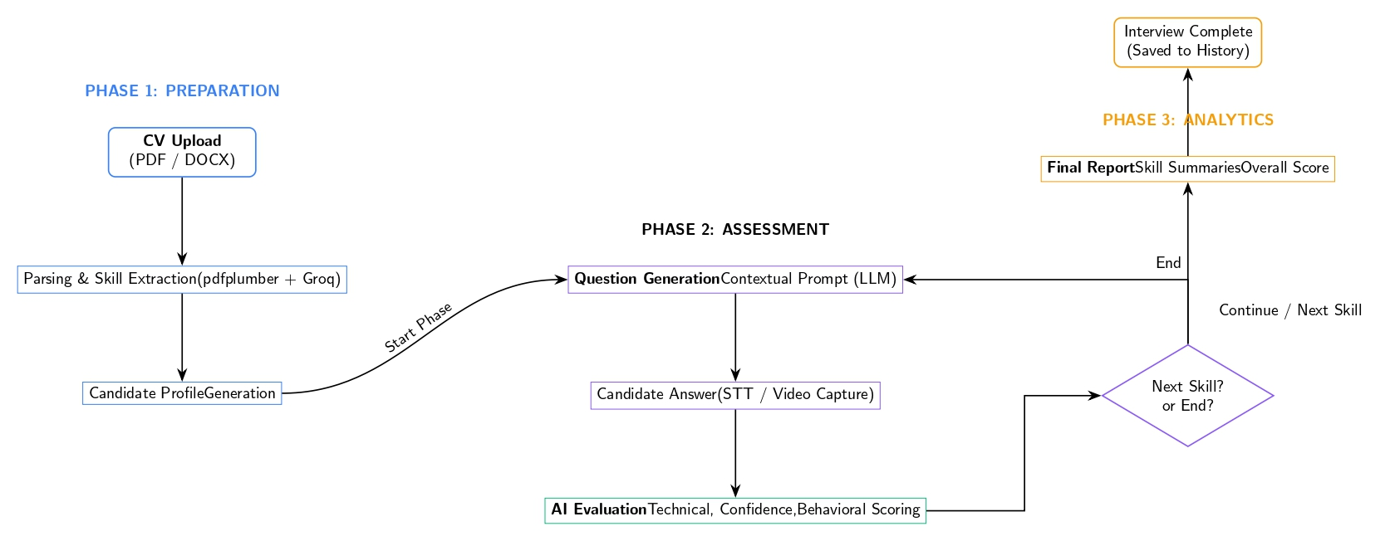
Proposed Methodology

Slide 21
Methodology - Data Collection & Analysis
Frameworks and Models:
Resume parsing using NLP
AI-based reasoning for interviews
Rule-assisted + LLM evaluation
Data Collection Techniques:
Resume PDFs (text input)
Job descriptions
Simulated interview answers
Test CV Pparsing
Data Analysis Procedures:
Text preprocessing
Skill extraction using keyword + semantic matching
AI-based qualitative evaluation

Slide 22
Methodology - Data Collection & Analysis
Project Execution Steps:
Signup and Login
Personalized Dashboard
Resume upload and parsing
Skill extraction
Question generation
Answer evaluation
Dashboard visualization
Quality Assurance Measures:
Modular testing
Controlled trial runs
Validation using known CV pairs
Safe defaults to prevent system crashes

Slide 23
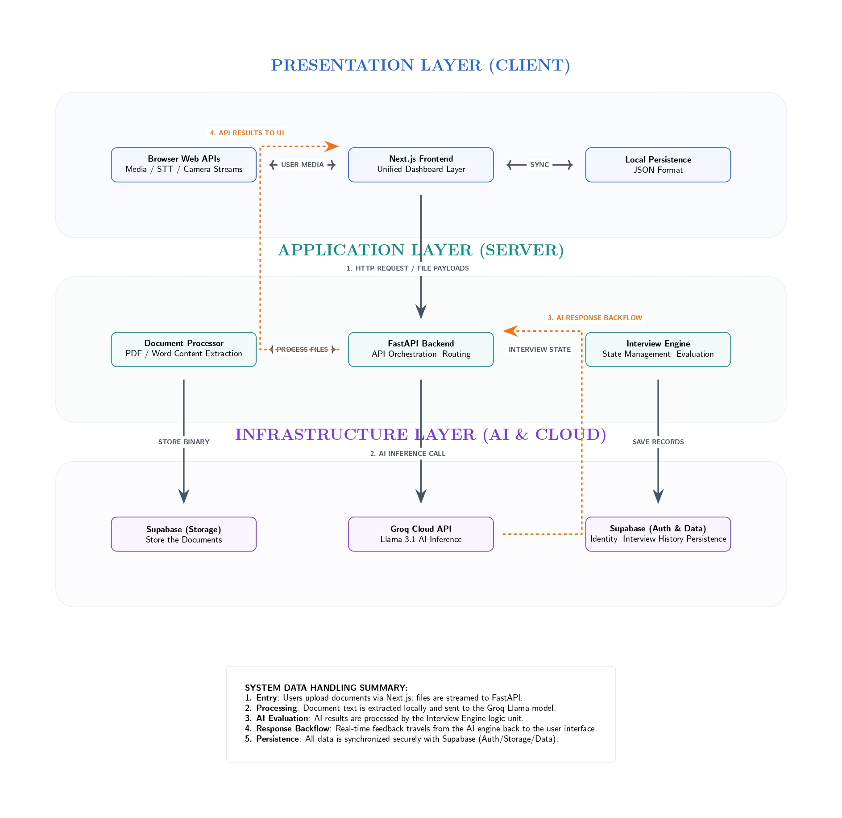
Design approach
Presentation Layer
Next.js frontend
Dashboard
Browser APIs for media input
Application Layer
FastAPI backend
Document processor
Interview engine
State management
Infrastructure Layer
Groq LLM API
Supabase authentication
Data storage
This layer-based design ensures modularity, scalability,
and maintainability.

Slide 24
Requirement Specification
Project Objectives
Develop an AI-based interview automation system.
Extract candidate skills automatically from resumes.
Generate skill-based interview questions using AI.
Conduct dynamic interviews with adaptive follow-up questions.
Evaluate candidate responses using LLM reasoning.
Provide automated interview feedback and reports
Data Requirements
The system processes the following data:
Candidate resumes (PDF/DOCX)
Extracted candidate skills
Candidate responses to interview questions
Interview evaluation metrics
All data is stored securely for interview history and analytics.
.
User Requirements
Users should be able to register and log in securely.
Users should be able to upload resumes for skill extraction.
Users should be able to start AI-based interview sessions.
Users should be able to submit answers via text or voice.
Users should receive AI-generated feedback and interview reports.

Slide 25
Requirement Specification
Functional Requirements (System Features)
User registration, login, and authentication.
Resume upload in PDF/DOCX formats.
Automatic resume parsing and skill extraction.
Generation of AI-based interview questions based on extracted skills.
Conduct dynamic interview sessions with adaptive follow-up questions.
Capture candidate responses through text, voice, or video input.
Perform AI-based evaluation of candidate responses (technical, communication, confidence).
Generate final interview reports and performance feedback.
Store interview history and results for future reference.
Non-Functional Requirements (System Performance & Constraints)
Performance: System should generate questions and evaluation results within a few seconds.
Scalability: System should support multiple concurrent users.
Security: Secure authentication and safe handling of candidate data.
Reliability: System should maintain stable operation during interview sessions.
Usability: Interface should be simple and user-friendly.
Maintainability: Modular architecture for easy updates and feature additions.
Operational Environment
Frontend: Next.js web application running in modern browsers.
Backend: FastAPI server handling API requests and interview logic.
AI Layer: Groq LLM API for question generation and response evaluation.
Storage: Supabase/Firebase for user data, resumes, and interview history.

Slide 26
Innovations
Novelty in Concept:
Resume-driven adaptive interview flow
Depth-based questioning (basic to advanced)
Capability classification (Strong / Medium / Weak)
Technological Innovation:
AI-generated evaluation summaries
Combined rule-based + AI reasoning

Slide 27
Sustainability, Impact and Future Application
Social / Industry Impact:
Fairer hiring
Reduced bias
Better candidate experience
Future Applications:
Corporate recruitment systems
University placement screening
Skill-based assessments
AI-driven HR analytics
Practicing the interview
Experiencing different modes of interviews

Slide 28
Hardware and/ or System Requirement
Hardware:
Standard personal computer or laptop
Minimum 8 GB RAM for smooth local server execution
Internet connection
Software:
Frontend: Next.js (React)
Backend: FastAPI
AI APIs (Groq)

Slide 29
References
[1] M. Chiranjeevi, “A Review Paper on Resume Parser Using AI,” International Journal of Creative Research Thoughts (IJCRT), vol. 12, no. 2, pp. 1–5, 2024.
[2] K. Waghmare, G. Patil, P. Bhalerao, and S. Shelke, “AI Bot for Interview Preparation,” International Journal of Scientific Research in Engineering and Management, 2024.
[3] P. Pandeya, S. Sharma, and A. Singh, “AI-Based Interview System with Machine Learning,” International Journal of Research Publication and Reviews, vol. 6, no. 2, pp. 1–6, 2025.
[4] A. Singh, R. Kumar, and S. Gupta, “AI-Powered Interview Assistant Chatbot,” International Journal of Scientific Research in Engineering and Development, vol. 8, no. 1, pp. 1–7, 2025.
[5] V. Verma, R. Singh, and P. Sharma, “AI-Powered Mock Interview System for Automated Skill Assessment,” International Journal of Scientific Research and Engineering Trends, vol. 11, no. 2, pp. 1–6, 2025.
[6] S. S. Chavan, P. Patil, and A. Deshmukh, “Automated Interview Bot for Hiring Process Optimization,” International Journal of Engineering Research & Technology, vol. 13, no. 4, pp. 1–5, 2024.

Slide 30
References
[7] S. Vasekar, A. Patil, and P. Kulkarni, “Automated Interview Assessment System,” International Journal of Novel Research and Development, vol. 10, no. 3, pp. 1–5, 2025.
[8] A. Caldera, S. Perera, and K. Silva, “Interview Bot: Automating Recruitment Process Using Natural Language Processing and Machine Learning,” Proceedings of the International Conference on Artificial Intelligence and Applications, pp. 45–50, 2023.
[9] G. N. Ashwath and G. Priyanka, “Best Practices in REST API Design for Enhanced Scalability and Security,” Journal of Artificial Intelligence, Machine Learning and Data Science, vol. 4, no. 2, pp. 120–128, 2024.
[10] S. Pati and Y. Zaki, “Evaluating the Efficacy of Next.js for Modern Web Applications,” arXiv preprint arXiv:2501.12345, 2025.
[11] S. Raghavan, I. Arsovski, and D. Maheshwari, “Groq LPU: A New Architecture for AI Inference,” Groq Technical Whitepaper, 2024.

Slide 31
Thank You

